Slide 1




survey results
A EU research project led by
SoDiMa is a project co-funded by the European Commission, Directorate General of Employment, Social Affairs & Inclusion VS/2019/0028 budget heading 04.03.01.08, Industrial Relations and Social Dialogue.

Slide 2
OVERVIEW OF SURVEYS AND FEEDBAKS^{(*)}
Country | Survey Innovative Companies | Survey Education & Training
Slovenia | 15/15 | 10/15
Spain | 8/15 | 9/15
^{(*)} ^{Data extracted on 31 Oct. 2019}

Slide 3
EDUCATION & TRAINING SURVEY RESULTS
Section 1 – Innovation & technology: impacts on skills & work organisation
The main drivers of change in EU Education and Training sector (first option for nr. of selections)
SLOVENIA | SPAIN
Learning tools; Technology (machines, ICTsystems) 6 | Tecnología (máquinas,sistemas TIC) 8

Slide 4
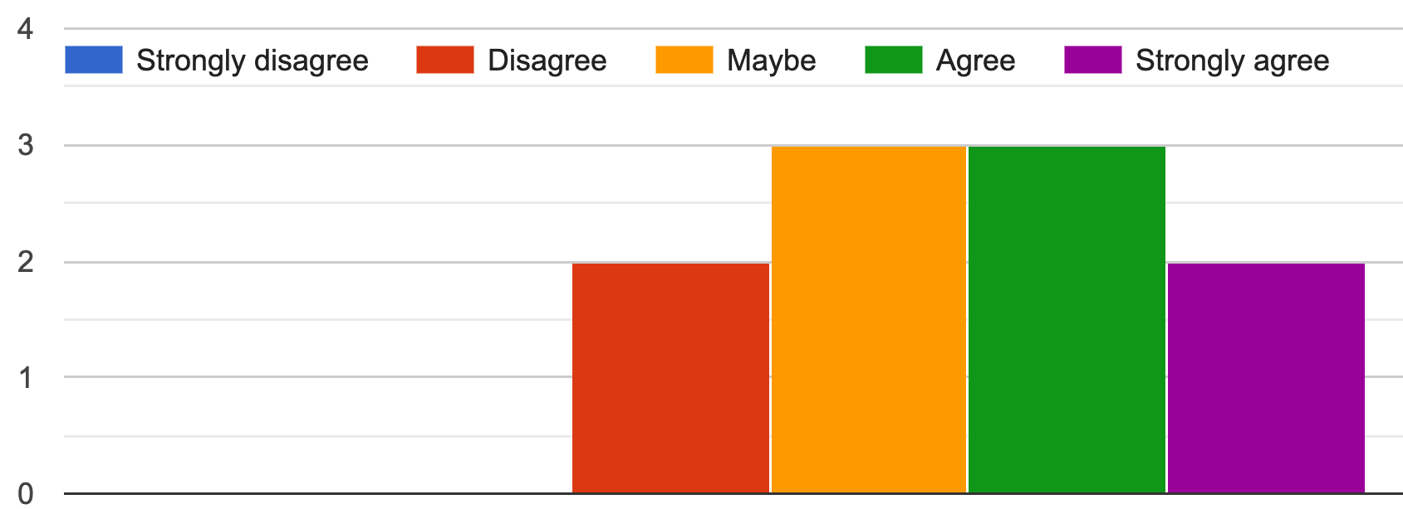
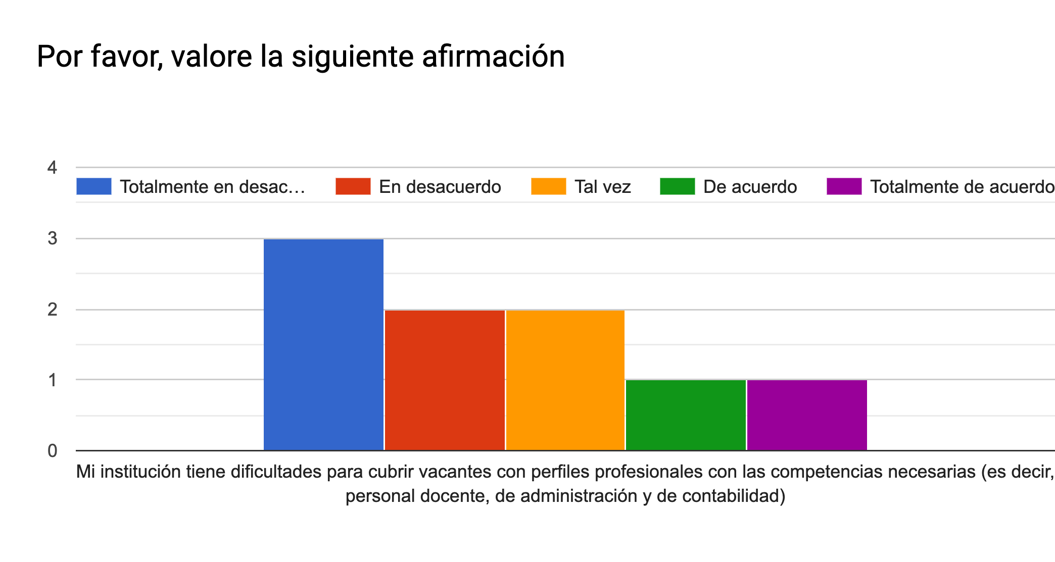
My Institution finds difficulty in supplying vacancies with professional profiles with the necessary skills (i.e. teaching,administration & accounting staff)
SLOVENIA
SPAIN

Slide 5
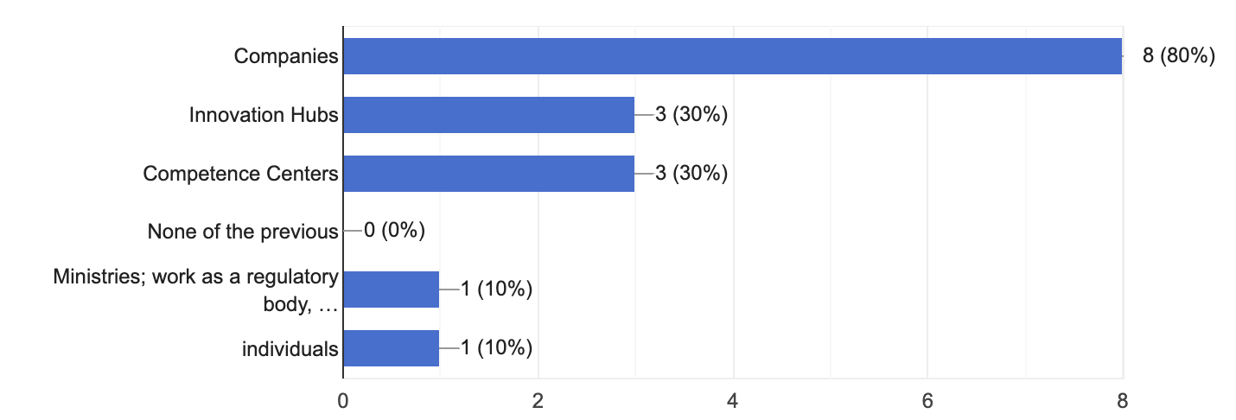
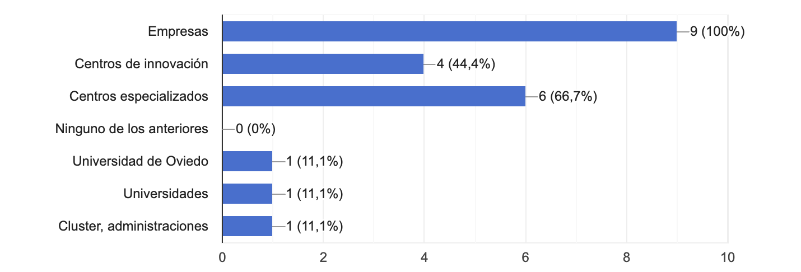
Local/National relationships
SLOVENIA
SPAIN
Notes:
Since it is a qualitative analysis, in the form of a opinion poll, percentages should not considered.

Slide 6
Reasons
for cooperations
SLOVENIA | Development of new products Better educated pupils Institutionally part of the Ministry (official statue) Developmet of occupational standards Companies are are one of ours biggest customers the second one are individuals. It depends what kind of educational program we provide. Competences centres are environments where new competences or needs of knowledge are recognized. Need for improvement of education, to meet the needs of students (and other learning population - adults, unemployed,...) to gain qualifications needed in life (at work, in private life, as active citizen,...)
SPAIN | Cliente / proveedor / colaborador Detección de necesidades formativas espacio de intercambio de información, prácticas en empresa, asesoramiento, etc Proyectos de investigación, prácticas del alumnado (FCT y PNL) Es muy importante conocer las necesidades del sector para intentar dar respuesta de cualificación de mano de obra Homologación para impartir formación en materia preventiva EMPRESAS: de forma obligada FCT y porque creemos que la FP Dual también consiste en mantener relaciones de colaboración con las empresas. UNIVERSIDADES: no están institucionalizadas, pero creemos que es la forma de estar más cerca del conocimiento formal Todo esto es más largo de explicar. Prácticas de alumnos principalmente Actualiazacion y transferencia de conocimiento
Notes:
Since it is a qualitative analysis, in the form of a opinion poll, percentages should not considered.

Slide 7
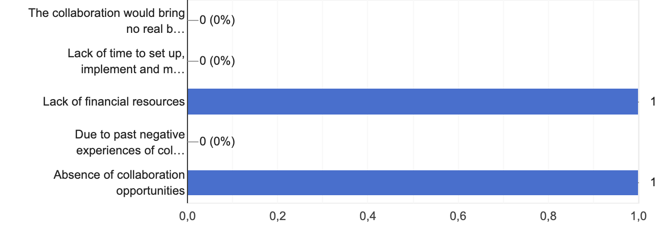
Reasons
for lack of relationship
SLOVENIA
SPAIN
Notes:
Since it is a qualitative analysis, in the form of a opinion poll, percentages should not considered.

Slide 8
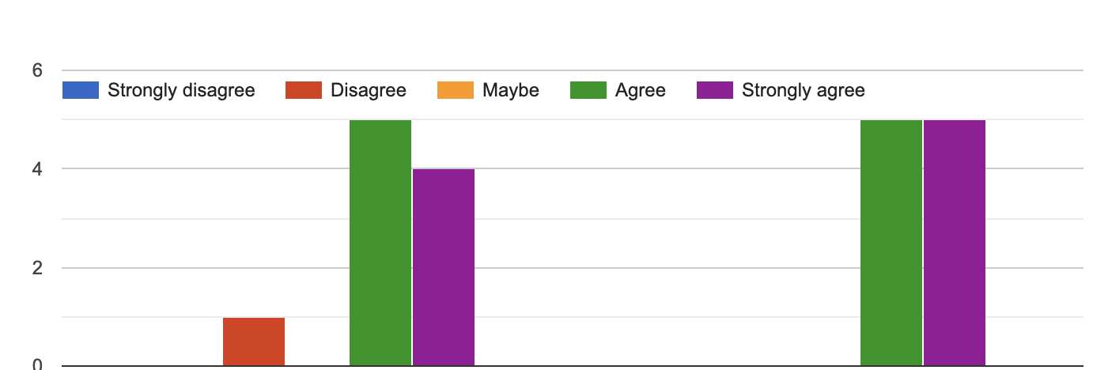
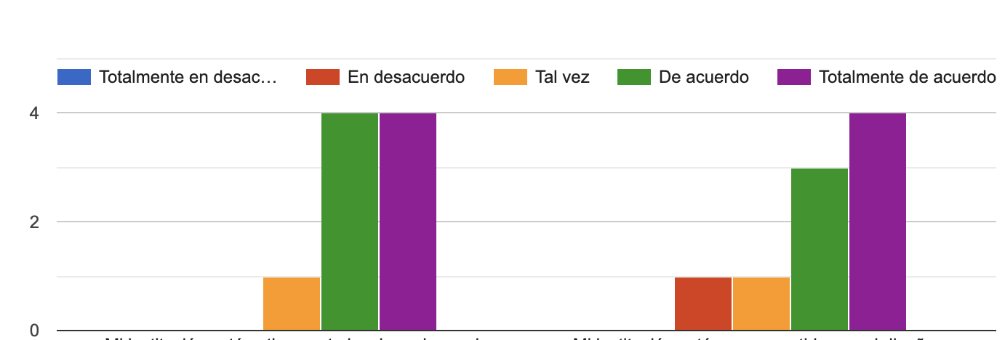
Upskilling, re-skilling, labour market, mobility and gender equality...
SLOVENIA
My Institution is actively involved in the development of up-skilling and re-skilling initiatives for its staff, supporting teachers, trainers and school principals, with a focus on continuous professional learning and development
My Institution is committed in designing and implementingactivities for students/trainees with a strong link with thelabour market, mobility and gender equality
SPAIN
Mi institución está activamente involucrada en el desarrollo de iniciativas de formación y recualificación profesional para su personal, profesores de apoyo, formadores y directores de centros, con un enfoque en el aprendizaje y desarrollo profesional continuo
Mi institución está comprometida con el diseño e implementación de actividades para estudiantes/alumnos con un fuerte vínculo con el mercado laboral, la movilidad y la igualdad de género
Notes:
Since it is a qualitative analysis, in the form of a opinion poll, percentages should not considered.

Slide 9
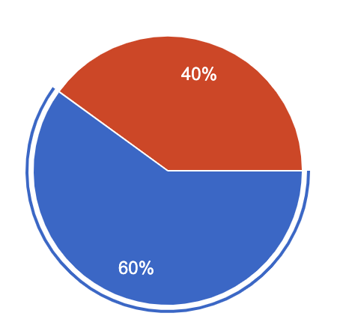
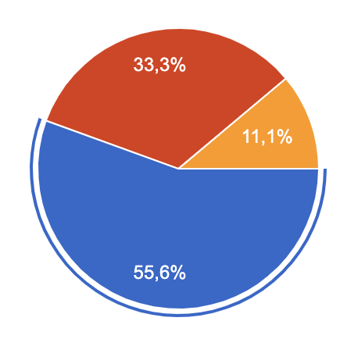
Design of new curricula (i.e. study programmes) focused on digital skills for the manufacturing sector in order to provide the skills needed by local/regional companies
SLOVENIA
SPAIN
NO
NO
No Sé
YES
YES
Notes:
Since it is a qualitative analysis, in the form of a opinion poll, percentages should not considered.

Slide 10
Design of new curricula: which are the main key skills (hard & soft) encompassed?
SLOVENIA
SPAIN
Coding, budgeting, communication
Sustainability, entrepreneurship skills, ICT, digitalization, individualization,...
Digitalisation, social skills, sustainable development
Knowledge of trends in the digital technologies; innovating strategies in business models; connecting business users with the capability of technology to digital solutions; use of predictive analytics, systemic thinking and agility of action,
Knowledge technical skills handwork
Entrepreneurship, communication, technical knowledge
Fabricación aditiva, automatización, sensórica,
Digitalización, idiomas, soft skills
Internet de les cosas (IOT), BIG DATA, ciberseguridad, industria 4.0
Competencias digitales, tecnológicas y educativas
Integra manipuladores y/o robots en sistemas mecatrónicos de procesos discretos y continuos controlados por PLC, optimizando el sistema y verificando su funcionamiento. Simula células robotizadas y prototipos mecatrónicos, validando su diseño mediante programas informáticos de simulación.
Notes:
Since it is a qualitative analysis, in the form of a opinion poll, percentages should not considered.

Slide 11
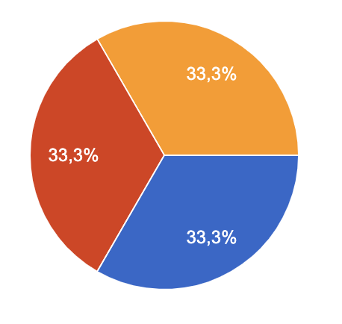
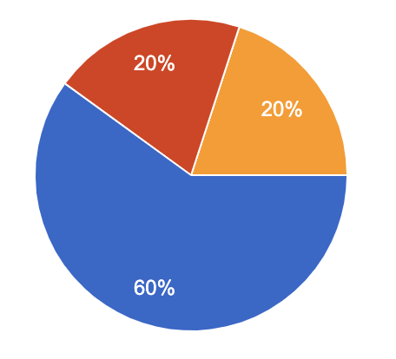
Have Institution been involved in skills anticipation, monitoring and analysis exercises at national and/or regional level?
SLOVENIA
SPAIN
NO
Don’t know
No Sé
NO
YES
YES
skills anticipation (survey for the future needs in industry)
focus groups activities with social partners to determine the key future skills in the sector
proyecto europeo: UPenAUTO, Cwic, Cwihe
estudios de resultados, análisis de competencias
actualización de cualificaciones, actualización de certificados de profesionalidad, creación de especialidades experimentales
Notes:
Since it is a qualitative analysis, in the form of a opinion poll, percentages should not considered.

Slide 12
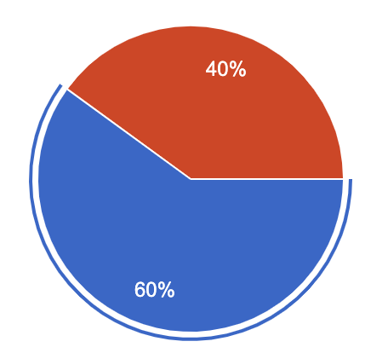
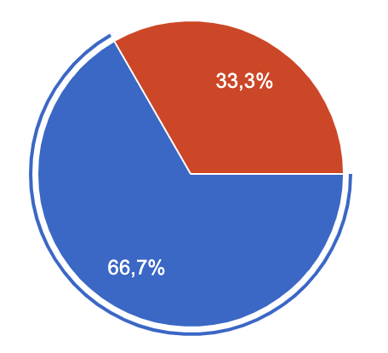
Are Institution involved in any dual learning program that allows students to get on-the-job training and classroom work/study? (alternance training: apprenticeships – internships)
SLOVENIA
SPAIN
NO
NO
YES
YES
Notes:
Since it is a qualitative analysis, in the form of a opinion poll, percentages should not considered.

Slide 13
The main learning/teaching tools to better align skills supply and demand in order to strengthen students/trainees’ employability at sectoral level (manufacture)
SLOVENIA
SPAIN
Formación basada en proyectos.
La estancia en empresas
Disponer de herramientas informáticas acordes al mercado laboral, una formación continua de formadores con el propósito de ofrecer a los alumnos nuevos conocimientos, así como colaborar con las empresas para que expongan sus necesidades laborales y formativas y ser nosotros participes de la formación tanto a sus trabajadores como a alumnos de escuelas profesionales
La colaboración entre empresas/fp/universidad de forma amplia. La empleabilidad sólo mejorará si lo hace la capacidad de aprendizaje del alumnado que finaliza sus estudios. No importa sólo lo que sabes hoy, sino lo que serás capaz de aprender mañana.
Formación en alternancia; profesorado actualizado e implicado, centros bien dotados tecnológicamente
Orientacion
Good educated teachers - theoretical and practical skills
Formal framework, teaching of teachers, job rotation, agreements, law,...
Practical training in modern technology based on a good theoretical basis
Theoretical and practical together
The ones which improve the samoinitiative, entrepreneurship, long-life learning. Active/interactive methods in school, practical lessons in school, project learning, learning by doing, WBL, ...
Entrepreneurship skills, personal development, personal goals aligned with career opportunities
Notes:
Since it is a qualitative analysis, in the form of a opinion poll, percentages should not considered.

Slide 14
Section 2 – Sectoral social dialogue - Education: insights and comments
Expectations about European Social Dialogue’s role within trends in education towards open and innovative education, including ICT.
SLOVENIA | SPAIN
I am not sufficiently informed to give an opinion To bring some new ideas Connecting different shareholders. Changing curriculum, more personal development in curriculum, more innovative approaches, more dialog, case studies, not so information oriented, | Concrección y cercanía a la realidad Mejora de la calidad educativa Las iniciativas ministeriales hacia la innovación, industria 4.0 y transformación digital de empresas, han canalizado las tendencias educativas y poco a poco los centros deben de ir asimilando que la industria evoluciona hacia ese frente, por lo tanto las TIC deben de ser fundamentales en cualquier marco educativo, mas si cabe en la fabricación mecánica, donde los tiempos de fabricación y los buenos resultados influyen de manera muy notable en los resultados económicos de las empresas No tengo expectativas claras sobre este aspecto Los agentes sociales y gobiernos deben favorecer centros mejor dotados tecnológicamente, más seguros y con profesionales que actualicen continuamente sus conocimientos Bajas expectativas

Slide 15
How social partners could help improve teachers' and school management teams' skills and working conditions?
SLOVENIA | SPAIN
With equipment and professional staff To support them To provide information about knowledge that is important for companies (their expectations based on needs) With active cooperation, with joint projects,... Change curriculums, follow best practice of other successful countries, personal development of teachers and management is a must, experiences in companies and in foreign countries is a must for management, personal growth in curriculum | Entornos de colaboración entre ambos, prácticos y reales. Apostando más activamente por la formación profesional Muy positivamente. Más colaboración entre todos y en todas las direcciones Presionando a las administraciones públicas para que inviertan en enseñanza e i+d+i; favoreciendo la colaboración entre centros educativos y empresas Influencia escasa

Slide 16
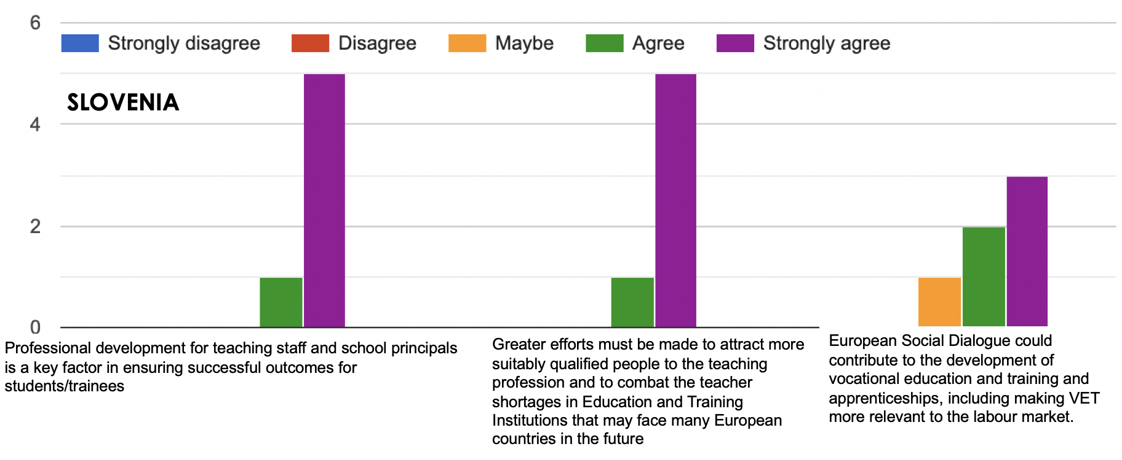
Professional development, VET, teaching profession...
Notes:
Since it is a qualitative analysis, in the form of a opinion poll, percentages should not considered.

Slide 17
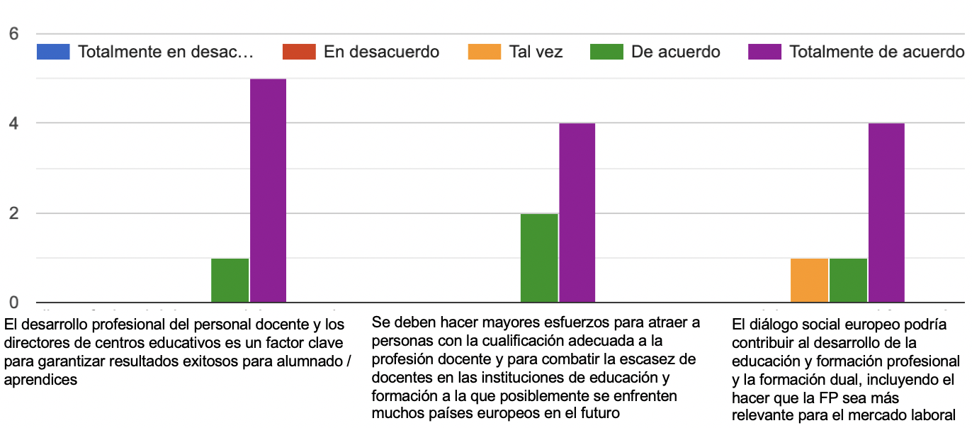
Professional development, VET, teaching profession...
SPAIN
Notes:
Since it is a qualitative analysis, in the form of a opinion poll, percentages should not considered.

Slide 18
Which measures Education and Training Institutions could take to solve today’s talents shortage while preparing their future workforce for success?
SLOVENIA | SPAIN
The profession is made interesting by companies and the social environment, and not schools Gap skills, curricula update, dialogue with all potential key players,... Providing the newest hardware and software. Continuous training of employees knowledge With more open curricula, individualisation of education,... Technology in primary school is not necessary, teacher need personal and interpersonal skills. Technology is only needed in special trainings. | Formación dual, formación de especialización a los egresados. Promover la actualización científico-técnica de los docentes Ser participe de las necesidades que tienen las empresas para encontrar personal formado, y dar respuesta a tal problema que los agentes sociales formen parte de esa colaboración con los centros para transmitir los problemas de formación de los trabajadores Mejorar la formación de los docentes Mostrar a la sociedad lo que hacemos en los centros docentes Implementar nuevas metodologías de enseñanza aprendizaje Adecuarse con mucha mayor rapidez a las necesidades del sistema productivo. Ha de ser más flexible la oferta formativa. Mejorar la orientación del alumnado. Autonomía de gestión de centros. Potenciar fp dual

