Slide 1




survey results
A EU research project led by
SoDiMa is a project co-funded by the European Commission, Directorate General of Employment, Social Affairs & Inclusion VS/2019/0028 budget heading 04.03.01.08, Industrial Relations and Social Dialogue.

Slide 2
OVERVIEW OF SURVEYS AND FEEDBAKS^{(*)}
Country | Survey Innovative Companies | Survey Education & Training
Italy | 15/15 | 2/15
Slovenia | 15/15 | 10/15
Spain | 8/15 | 9/15
^{(*)} ^{Data extracted on 31 Oct. 2019}

Slide 3
INNOVATIVE COMPANIES SURVEY RESULTS
Section 1 – Innovation & technology: impacts on skills & work organisation
The main drivers of change in EU workplaces (first three options for nr. of selections)
ITALY | SLOVENIA | SPAIN
Technology (machines, ICT systems) | Technology (machines, ICT systems) | Tecnología (máquinas,sistemas TIC)
Products or services | Organisational model | Cambios de medio ambiente / sostenibilidad
Organisational model | Products or services | --

Slide 4
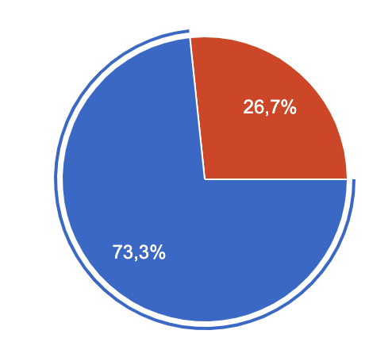
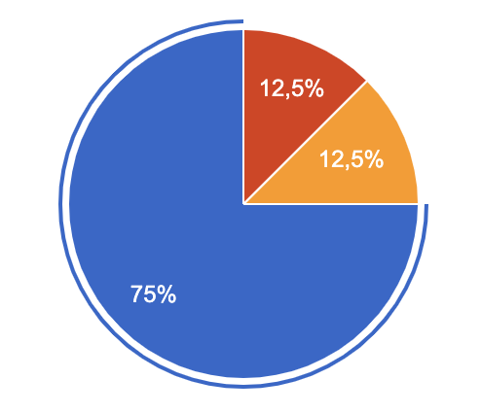
Section 1 – Innovation & technology: impacts on skills & work organisation
During the past 5 years, has your Company made substantial investments to digitize the production process/its main activities?
ITALY | SLOVENIA | SPAIN
NO
NO
NO
No sé
YES
YES
YES

Slide 5
Section 1 – Innovation & technology: impacts on skills & work organisation
Main Technologies introduced (first three options for nr. of selections)
ITALY | SLOVENIA | SPAIN
Internet of things Big data analytics Additive Manufacturing | Simulation Advanced Manufacturing Solutions (e.g. autonomous robots) Additive Manufacturing | Big Data y análisis de datos Internet de las cosas Soluciones avanzadas defabricación (por ejemplo, robots autónomos)

Slide 6
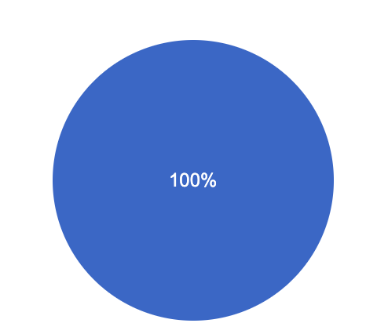
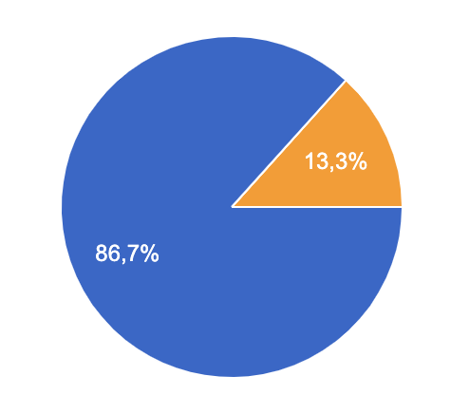
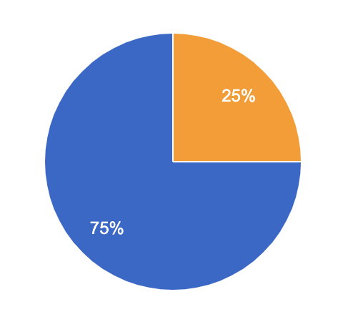
Section 1 – Innovation & technology: impacts on skills & work organisation
Willigness to invest in digital technologies in the future
ITALY | SLOVENIA | SPAIN
Don’t know
No sé
YES
YES
YES

Slide 7
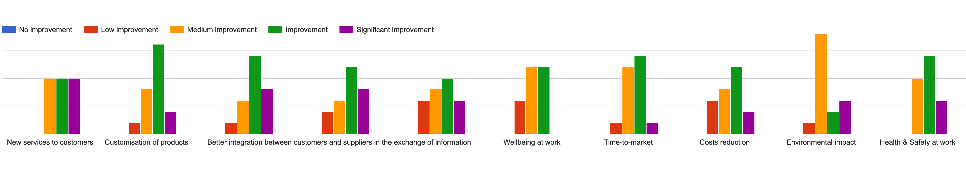
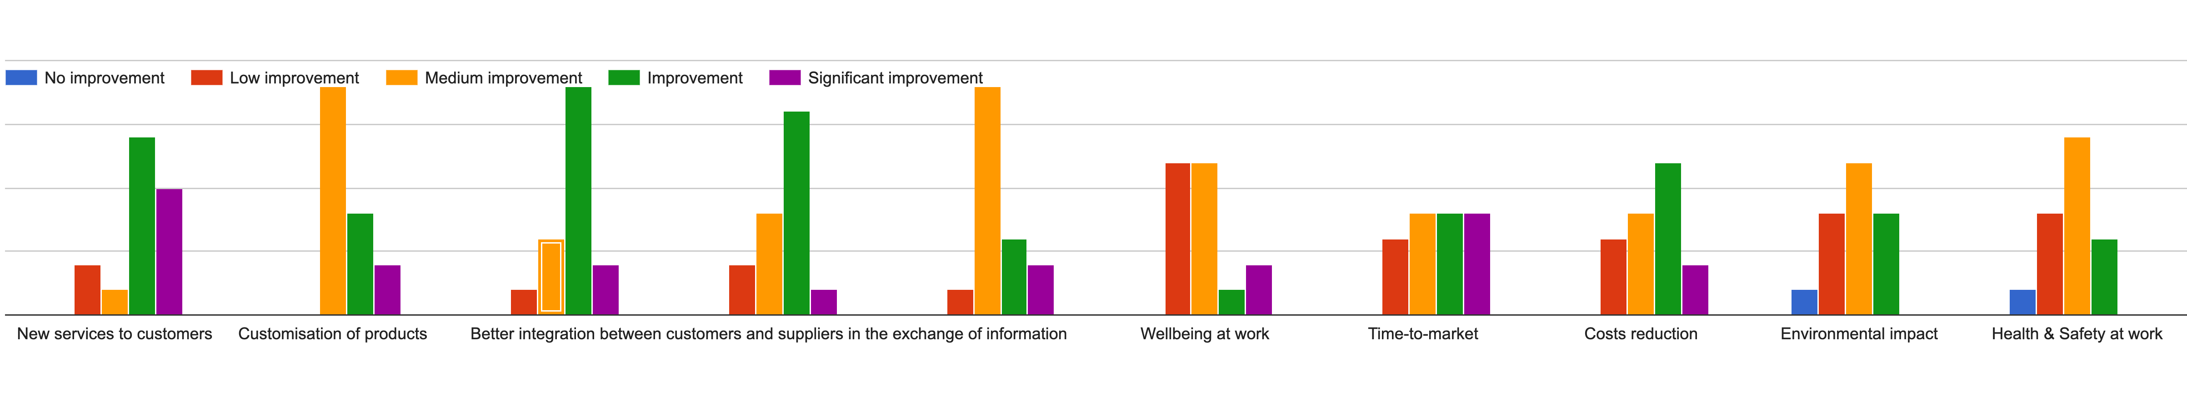
Use of digital technologies: main expected benefits
ITALY
SLOVENIA
Reduction in delivery schedules and flexibility
in response to a customer’s request
Better integration between customers and suppliers in the exchange of information
Labour Productivity improvements

Slide 8
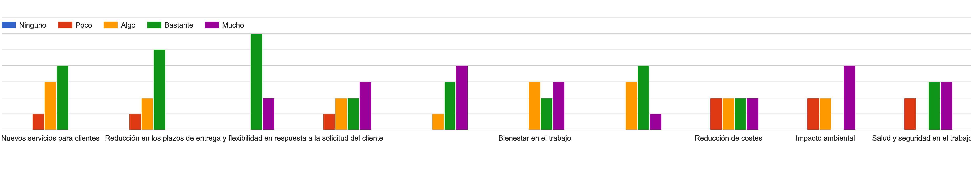
Use of digital technologies: main expected benefits
SPAIN
Personalización de productos
Reducción en los plazos de entrega y flexibilidad en respuesta a la solicitud del cliente
Mejor integración entre clientes y proveedores en el intercambio de información
Mejoras en la productividad laboral
Bienestar en el trabajo
Tiempo de salida al mercado (time-to-market)
Labour Productivity improvements

Slide 9
Introduction of digital technologies & Jobs changes
Changes in the content of work
ITALY | SLOVENIA | SPAIN
Old jobs have been enriched by new tasks 8 New jobs have emerged 4 Old jobs have disappeared 2 Don't know 1 | Old jobs have been enriched by new tasks 12 New jobs have emerged 1 Old jobs have disappeared 1 Don't know 1 | Antiguos puestos se han enriquecido con nuevas tareas 6 Han desaparecido antiguos puestos 1 No sé 1
ITALY | SLOVENIA | SPAIN
There has been an increase in the cognitive content of work 12 (Analysis of data; Decision-making; Suggestions for improvement) There has been a decrease in the cognitive content of work 1 Don't know 2 | There has been an increase in the cognitive content of work 10 (Problem-solving; Decision-making; Analysis of data; Increased relations with colleagues) There has been a decrease in the cognitive content of work 1 Don't know 4 | There has been an increase in the cognitive content of work 5 (Resolución de problemas; Propuestas de mejora; Toma de decisiones) There has been a decrease in the cognitive content of work 1 Don't know 2
Notes:
Changes in the content of work: examples in brackets refer to the first three options for number of selections. Question = «Please, describe it». SLO: Analysis of data; Increased relations with colleagues = 4 selections each.

Slide 10
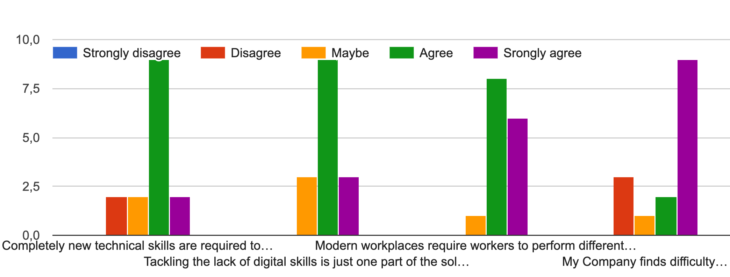
Respondents have been asked to rate the following statements
ITALY
Labour Productivity improvements
Why ?
Completely new technical skills are required to deal with new technologies
Abordar la falta de competencias digitales es solo una parte de la solución, que necesita ser complementada con el desarrollo de otras competencias técnicas y de comportamiento
Los lugares de trabajo modernos requieren diferentes tareas, mejorando así su versatilidad
My Company finds difficulty in supplying vacancies with professional profiles/talents with the necessary skills.
Specific industrial area, high market competition, lack of experienced professionals
No technical skills for ouR specific production processes
Limited number of graduated persons with skills in ultimate software frameworks (nodejs, mongoDB etc.) and BIgData and AI competencies
University students do not have practical experience during their study
No school preparation connect with the company needs
No schools curricula: because the world go more quickly than the school. people have "know how" but lost "know how to do”
In Italy the collaboration work to school/university is to be improved
Big gap between the school and required job competencies
Not enough school programs near the companies need. No way to find technically skilled people, just take young people and train then yourself.
Because the junior and senior profiles have difficulties with the new digital approach

Slide 11
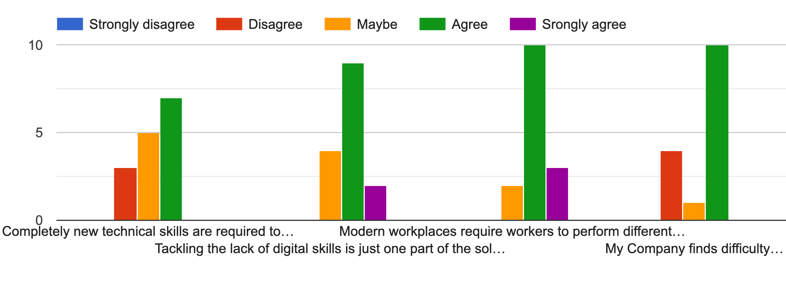
Respondents have been asked to rate the following statements
SLOVENIA
Completely new technical skills are required to deal with new technologies
Tackling the lack of digital skills is just one part of the solution, that needs to be complemented with the development of other technical and behavioral skills
Modern workplaces require workers to perform different tasks, thus improving their versatility
My Company finds difficulty in supplying vacancies with professional profiles/talents with the necessary skills.
Why ?
No personnel available
High demand for professional staff
Competition on labor market, not an attractive industry, work conditions
Market need is bigger than available resources
Competences have to be on higher level
The lack of some necessary skills, when they finish education
No schools curricula, there is not enough technical staff
Little suitable professionals in this field
No available students on the market
No schools curricula

Slide 12
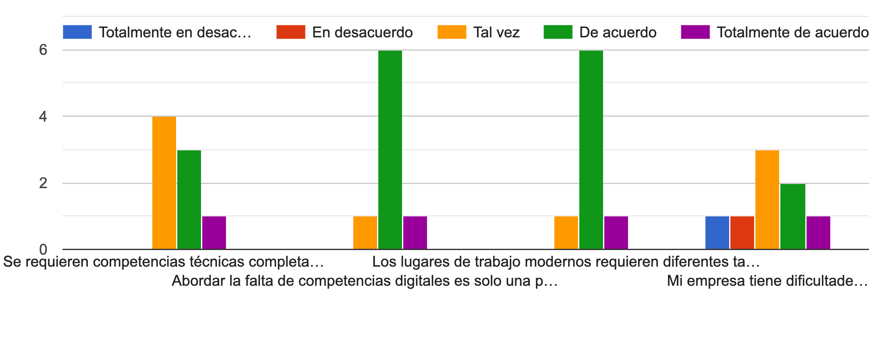
Respondents have been asked to rate the following statements
SPAIN
Se requieren competencias técnicas completamente nuevas para tratar con nuevas tecnologías
Abordar la falta de competencias digitales es solo una parte de la solución, que necesita ser complementada con el desarrollo de otras competencias técnicas y de comportamiento
Los lugares de trabajo modernos requieren diferentes tareas, mejorando así su versatilidad
Mi empresa tiene dificultades para cubrir vacantes con perfiles / talentos profesionales con las competencias necesarias.
Why ?
No estandarizado, falta de formación
No hay profesionales cualificados
No hay programas de enseñanza y tampoco interes por parte de los trabajadores
No hay formación adecuada a las necesidades especificas
En zonas industriales cuesta encontrar perfiles técnicos

Slide 13
Companies’ responses to workers’ lack of necessary skills
Changes in the content of work
ITALY | SLOVENIA | SPAIN
Training programmes 12 Selection of new professional figures 2 Job rotation 1 | Training programmes 10 Selection of new professional figures 2 Job rotation 2 Self education 1 | Training programmes 4 Selection of new professional figures 3 Job rotation 1
Average age of workers involved in vocational training/re-training courses organized by companies
ITALY | SLOVENIA | SPAIN
25-29 years 9 45-54 yerars 7 | 25-29 years 4 45-54 yerars 6 | 25-29 years 1 45-54 yerars 3
Notes:
Changes in the content of work: examples in brackets refer to the first three options for number of selections. Question = «Please, describe it». SLO: Analysis of data; Increased relations with colleagues = 4 selections each.

Slide 14
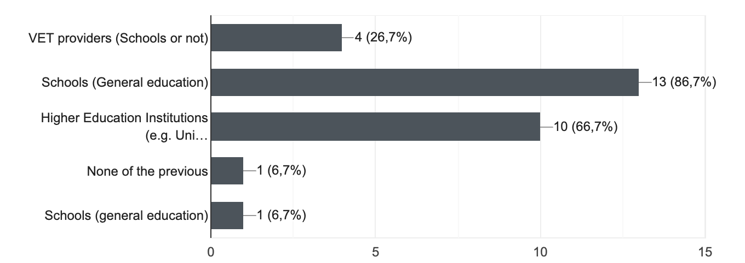
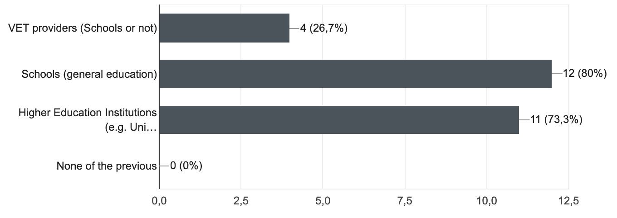
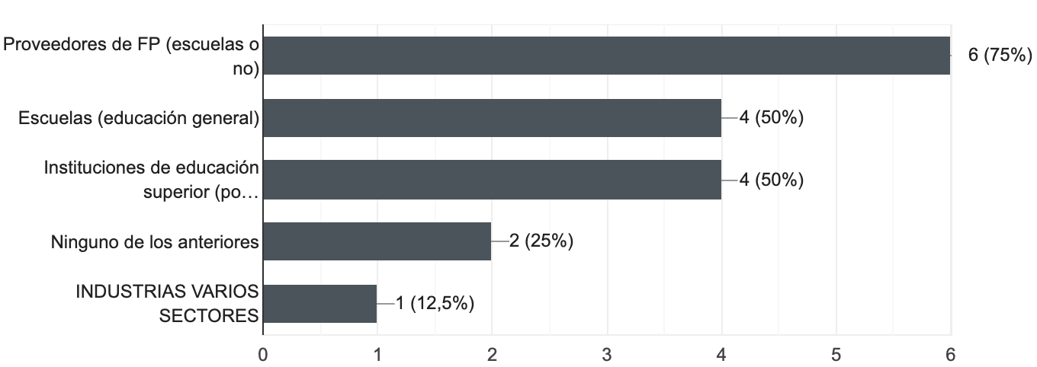
Local/National relationships
ITALY
SLOVENIA
SPAIN
Notes:
Since it is a qualitative analysis, in the form of a opinion poll, percentages should not considered.

Slide 15
Reasons
for the lack of local/national connections with education and training providers
ITALY | Lack of time to set up, implement and maintain the collaboration; Lack of financial resources; Absence of collaboration opportunities
SLOVENIA | The collaboration would bring no real benefit to the Company Lack of time to set up, implement and maintain the collaboration
SPAIN | Falta de recursos financieros; Ausencia de oportunidades de colaboración Debido a experiencias anteriores de colaboración negativas Falta de recursos financieros
Notes:
Since it is a qualitative analysis, in the form of a opinion poll, percentages should not considered.

Slide 16
How has the organization of work changed in your Company?
ITALY | Flatter hierarchies (reduction in the number of supervisors) 8 Direct employee participation practices (e.g. via continuous improvement groups) 10 Centralisation of power and decreased autonomy Outsourcing of activities Internalisation of activities Don't know
SLOVENIA | Flatter hierarchies (reduction in the number of supervisors) 10 Direct employee participation practices (e.g. via continuous improvement groups) 8 Centralisation of power and decreased autonomy Outsourcing of activities Internalisation of activities Don't know
SPAIN | Flatter hierarchies (reduction in the number of supervisors; Direct employee participation practices (e.g. via continuous improvement groups) 4 Centralisation of power and decreased autonomy Outsourcing of activities 5 Internalisation of activities Don't know
Notes:
Since it is a qualitative analysis, in the form of a opinion poll, percentages should not considered.

Slide 17
Industrial/employee relations digitalization
Section 2 – Industrial/Employee relations
ITALY | SLOVENIA | SPAIN
It has been necessary to initiate negotiations over some crucial topics 1 Cooperative industrial relations have allowed to find efficient solutions to critical aspects 6 Digital innovation has brought about serious conflicts between management and workers’ representatives 3 Industrial relations have not affected and been affected by digitalization 8 | It has been necessary to initiate negotiations over some crucial topics 4 Cooperative industrial relations have allowed to find efficient solutions to critical aspects 8 Digital innovation has brought about serious conflicts between management and workers’ representatives 1 Industrial relations have not affected and been affected by digitalization 5 | It has been necessary to initiate negotiations over some crucial topics 1 Cooperative industrial relations have allowed to find efficient solutions to critical aspects 3 Digital innovation has brought about serious conflicts between management and workers’ representatives 1 Industrial relations have not affected and been affected by digitalization 6
Negotiations' main area of reference (first two options for number of selections)
Organisation of work Workers’ skills development | Organisation of work Workers’ skills development | Política salarial Organización del trabajo Desarrollo de competencias
Notes:
Since it is a qualitative analysis, in the form of a opinion poll, percentages should not considered.

Slide 18
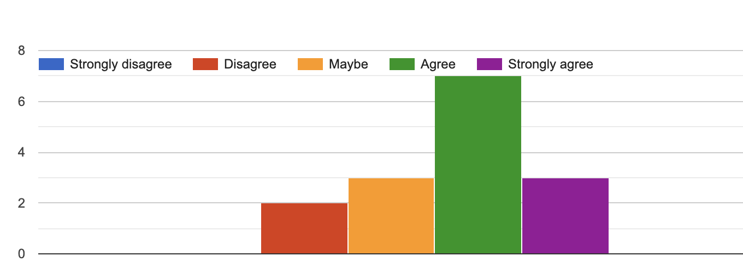
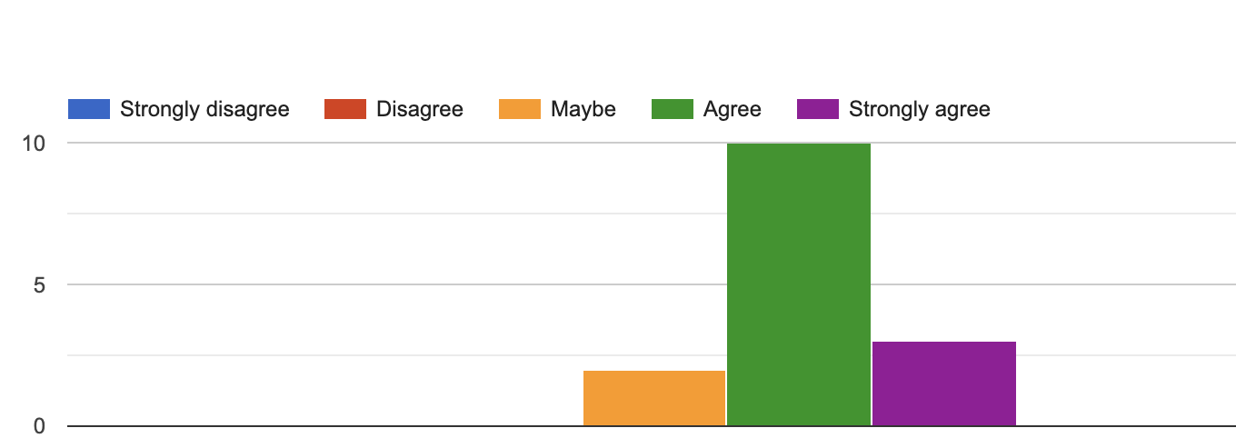
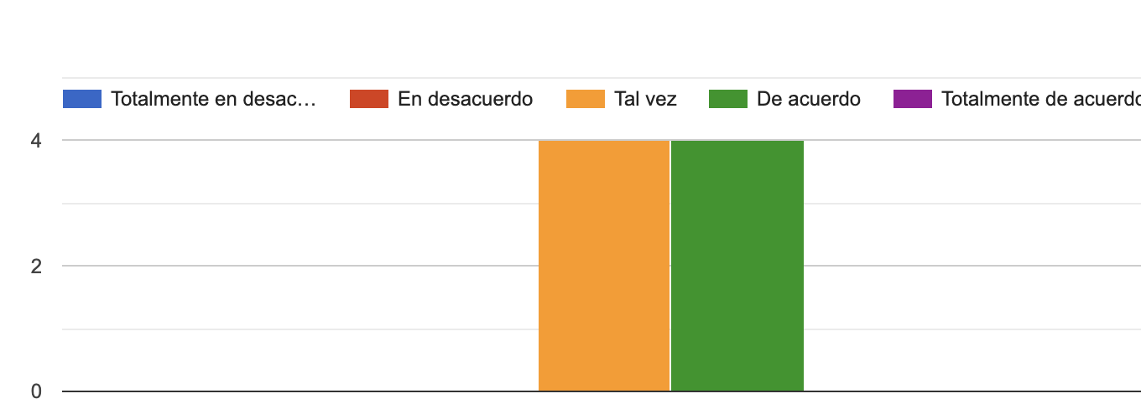
Reasons behind conflicts between management and workers’ representatives
ITALY | SLOVENIA | SPAIN
No big conflicts: just negotiations on targets for salary awards No conflicts | Company organization does not follow the transition Extending the responsibility, more skills needed. Workers must constantly adapt to production requirements (priorities) | Los trabajadores afectados con mayores competencias y responsabilidades reclaman aumento de salario Somos una empresa pequeña, no hemos llegado a ese punto No tenemos conflictos
Industrial relations are relevant enabler of technological and organizational innovation
ITALY | SLOVENIA | SPAIN
Notes:
Since it is a qualitative analysis, in the form of a opinion poll, percentages should not considered.

Slide 19
Section 3 – European Social Dialogue and final considerations
Expectations about European Social Dialogue’s role within innovations and technological-based changes occurring in the manufacturing sector
ITALY | SLOVENIA | SPAIN
// | No expectations operative conections in sector, practical examples of goog practise | Espero que la innovación y los cambios tecnológicos definan nuevos y más puestos de trabajo y que los jovenes altamente cualificados no tengan de abandonar su pais de origen para poder trabajar No tengo criterio
Notes:
Since it is a qualitative analysis, in the form of a opinion poll, percentages should not considered.

Slide 20
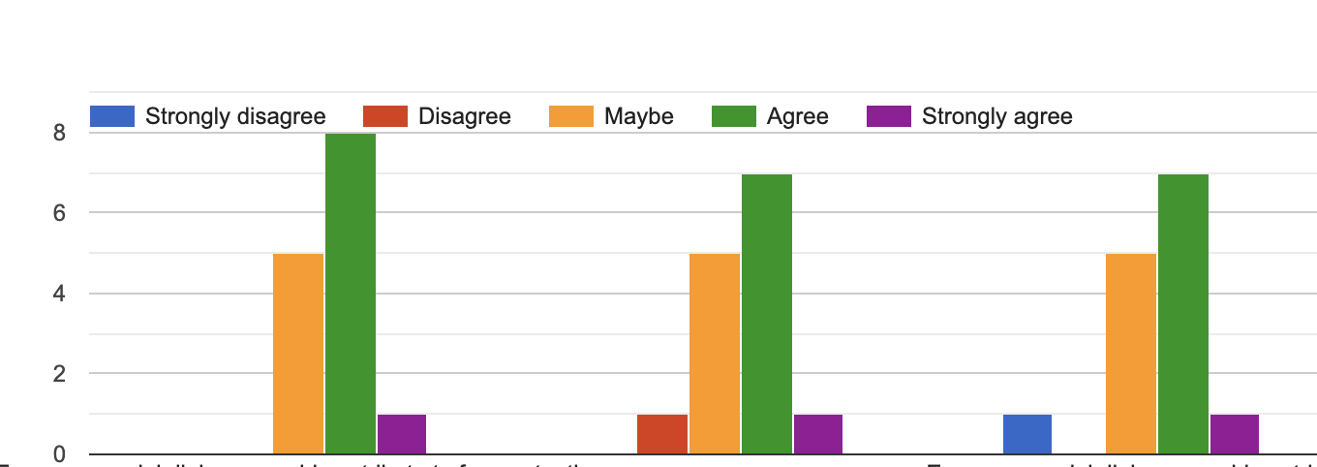
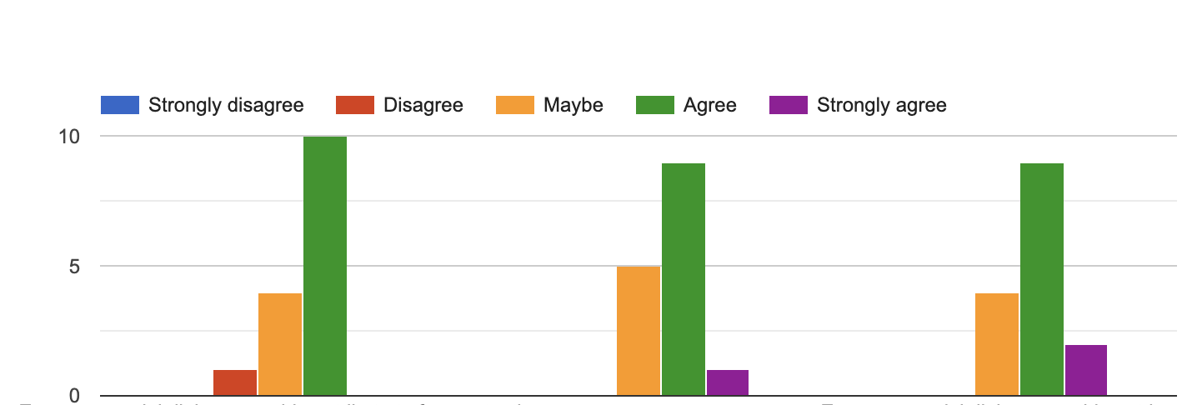
ITALY
European social dialogue could contribute to face potential social and work problems related to digitalization of manufacturing through the provision of specific guidelines for Member States.
European social dialogue could contribute to guarantee a fair transition towards digital manufacturing combining new production paradigm with protection of workers.
European social dialogue could contribute to set up new schemes of work organization (i.e. working time, smart working) and reskilling strategies shared by social partners..
SLOVENIA
European social dialogue could contribute to face potential social and work problems related to digitalization of manufacturing through the provision of specific guidelines for Member States.
European social dialogue could contribute to guarantee a fair transition towards digital manufacturing combining new production paradigm with protection of workers.
European social dialogue could contribute to set up new schemes of work organization (i.e. working time, smart working) and reskilling strategies shared by social partners..
Notes:
Since it is a qualitative analysis, in the form of a opinion poll, percentages should not considered.

Slide 21
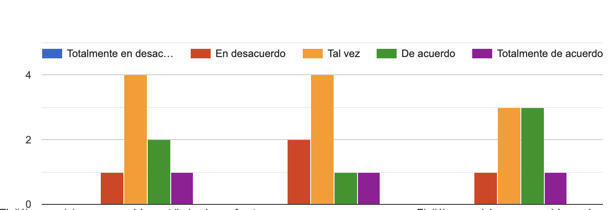
SPAIN
El diálogo social europeo podría contribuir a hacer frente a posibles problemas sociales y laborales mediante la elaboración de directrices específicas para los Estados miembros
El diálogo social europeo podría contribuir a una transición justa hacia la fabricación digital combinando un nuevo paradigma de producción con la protección de los trabajadores
El diálogo social europeo podría ayudar a establecer nuevos sistemas de organización del trabajo (es decir, tiempo de trabajo, trabajo inteligente) y estrategias de formación de trabajadores acordadas por los agentes sociales
Notes:
Since it is a qualitative analysis, in the form of a opinion poll, percentages should not considered.

Slide 22
If jobs are changing due to technology and automation, what measures manufacturers could take to solve today’s talents shortage while preparing their future workforce for success?
ITALY | Create an environment more suitable for millenians, arrange some internal specific training withe the support of consultants Training program, soft skills improvement, development plans to improve the motivation and to increase the workforce know how "Alternanza Scuola lavoro", cooperating with universities in preparing updated study programs Train people after or during school Anticipate training, anticipate recruitment if not necessary now Giving support for stagers in the company's operations, continuously improving skills of workers with courses and offers for education Engage in professional degree teaching, hosting internships 1- the work have to enter into the school 2- involve the worker with the real examples It is necessary to provide employees with the right technological tools to face future commitments in the world of digitization and to create the right mindset throughout the company. We are training all the employees and workers in order to try to fill the knowledge gap and be ready for the next technology steps. Trainig necessary for new technologies Less academic school approach
Notes:
Since it is a qualitative analysis, in the form of a opinion poll, percentages should not considered.

Slide 23
SLOVENIA | Companies could teach their own personnel, maybe some online learning Workers motivation, wages pro knowledge,..... Collaboration with educational institutions, educating employees in new technologies Develop people, grow in personal knowledge Work from home, Reorganization, people incentivisation Training, job rotation Internal trainings, salary policies changes to assure attractiveness for higher and more productive profiles. Reduction of working time, higher flexibility. External and internal education, higher salaries for technologically demanding work No activities have been undertaken yet
SPAIN | Incrementar la presencia en centros de enseñanza El problema no son los empleos, es la mentalidad de cada vez trabajar menos. Más formación técnica específica y subvencionada cursos de formacion FP Formación a medida y promoción interna formación Desarrillo profesional en la empresa
Notes:
Since it is a qualitative analysis, in the form of a opinion poll, percentages should not considered.

